Slide 1
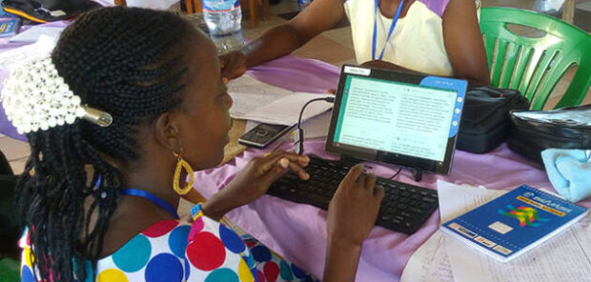
The 8 Steps of MAST
Topic 3: Session 1

Slide 2
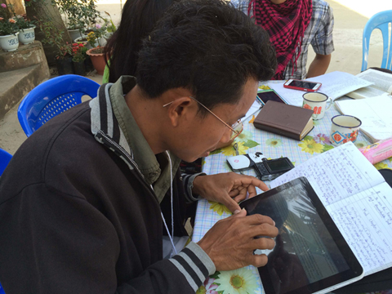
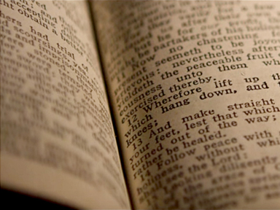
MAST: Mobilized Assistance Supporting Translation
Designed to help translators produce a quality, meaning-based translation

Slide 3
The First 4 Steps: Drafting
Step 1
Consume
Read the text thoughtfully, paying attention to the flow and the main points.
Step 2
Step 3
Step 4

Slide 4
The First 4 Steps: Drafting
Step 1
Consume
Step 2
Verbalize
Tell someone what you read.
Step 3
Step 4

Slide 5
The First 4 Steps: Drafting
Step 1
Consume
Step 2
Verbalize
Step 3
Chunk
Divide the text into chunks you can learn and remember.
Step 4

Slide 6
The First 4 Steps: Drafting
Step 1
Consume
Step 2
Verbalize
Step 3
Chunk
Step 4
The Blind Draft
Read a chunk, close the source text, and draft the chunk from memory. Do this with all the chunks in the chapter.

Slide 7
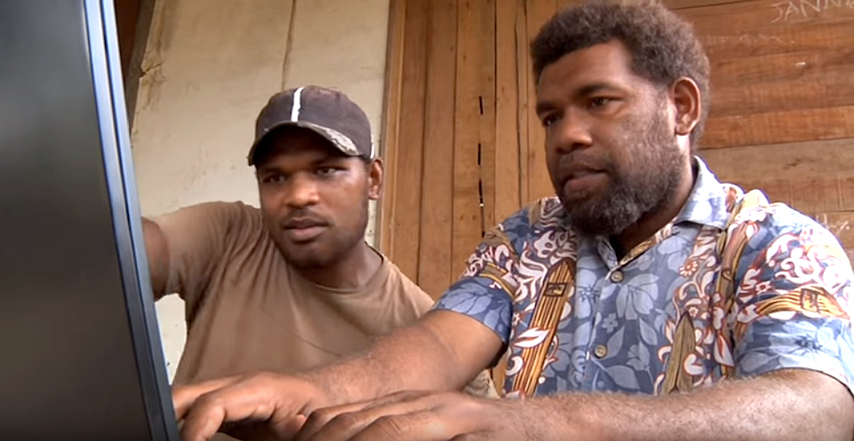
Encouraging New Translators
Share your experience.
Reassure them that they can fix their draft during the checking steps.
If they try these steps, they will understand them better.

Slide 8
4 Steps Completed
One Chunk
= a draft of several verses
Repeat Step 4 for a whole chapter
Next:
the 4 checking steps of MAST.

Slide 9


